Slide 1
WEEK 3 Journey PPT
BY Thosic Tarun Bellana

Slide 2
Day 1 – Azure storage overview
We were given an overview on Azure Storage.
It offers a variety of storage solutions to help organizations store, manage, and access their data in a scalable, reliable, and secure manner.
Azure Storage is widely used by businesses and developers for a wide range of applications, including data storage, backup, disaster recovery, and application development.
We learned how to create a storage account and how to work with containers.
We also learned about the different data services such as the Blob , Queue, and Table services
Also learned out LRS and GRS. LRS and GRS are different redundancies of the Azure storage. LRS stands for Locally Redundant Storage, which means that data is stored three times within a single region. GRS stands for Geo-Redundant Storage, which provides additional redundancy for data storage compared to LRS
Blob Storage is designed for storing unstructured data, such as documents, images, videos, and backups.

Slide 3
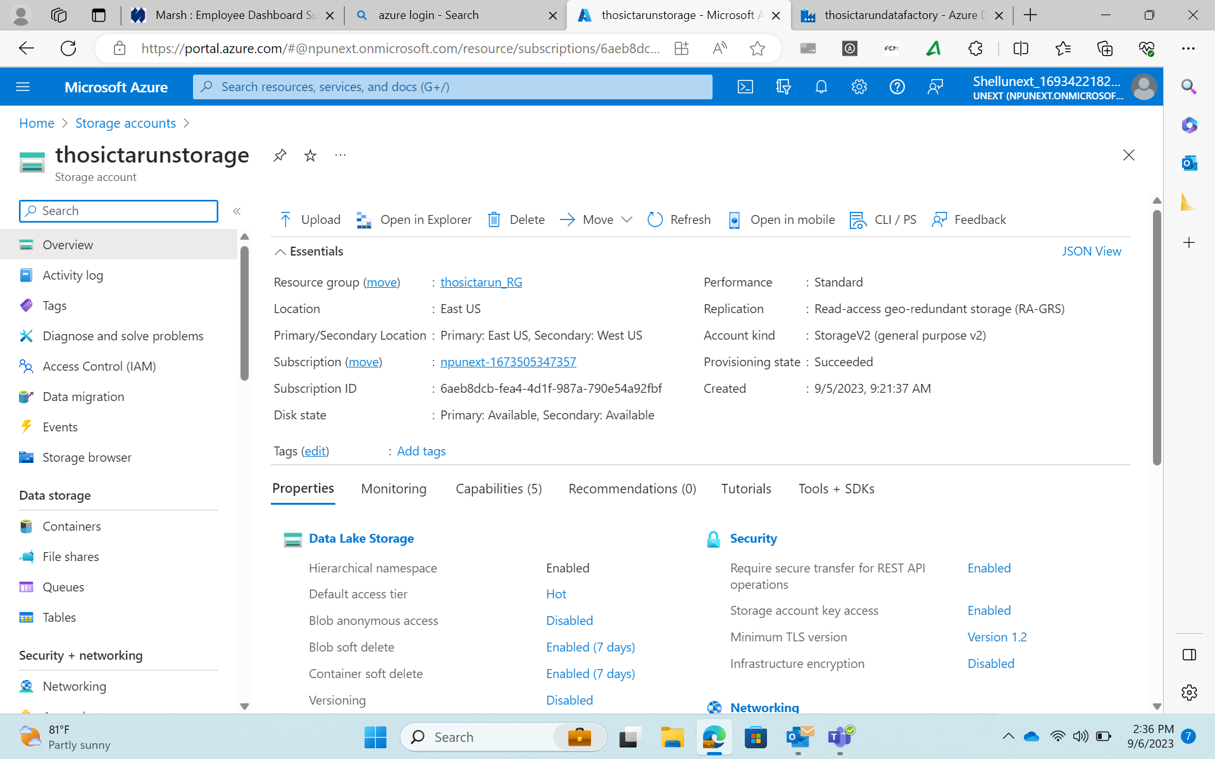

Slide 4
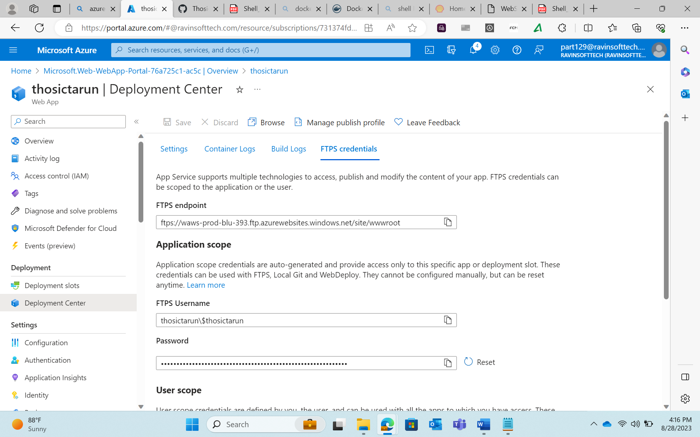

Slide 5
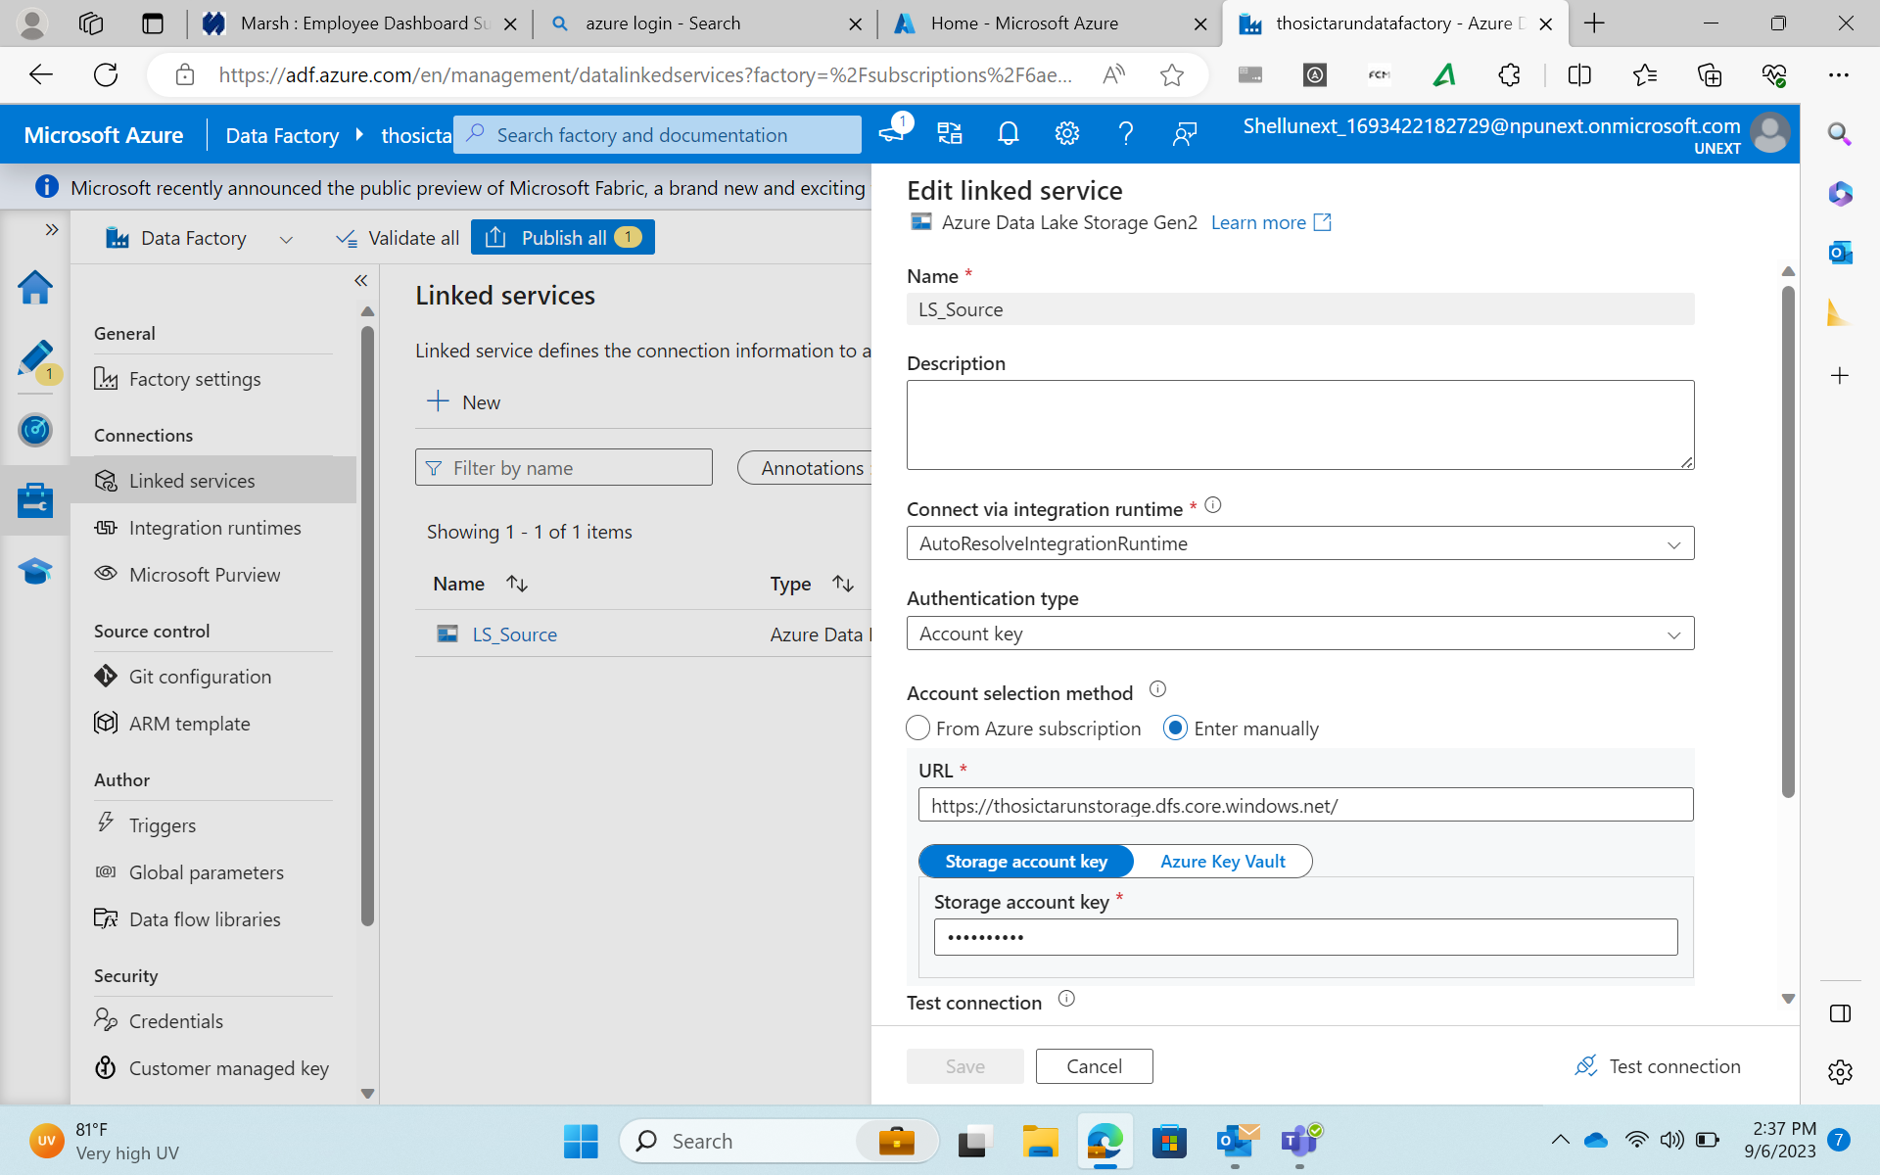

Slide 6
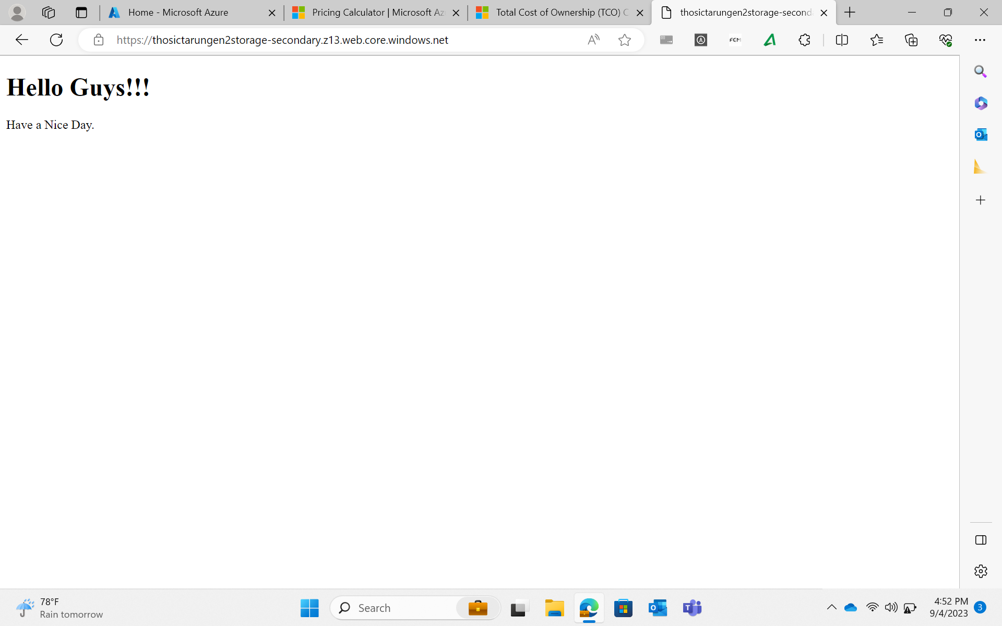

Slide 7
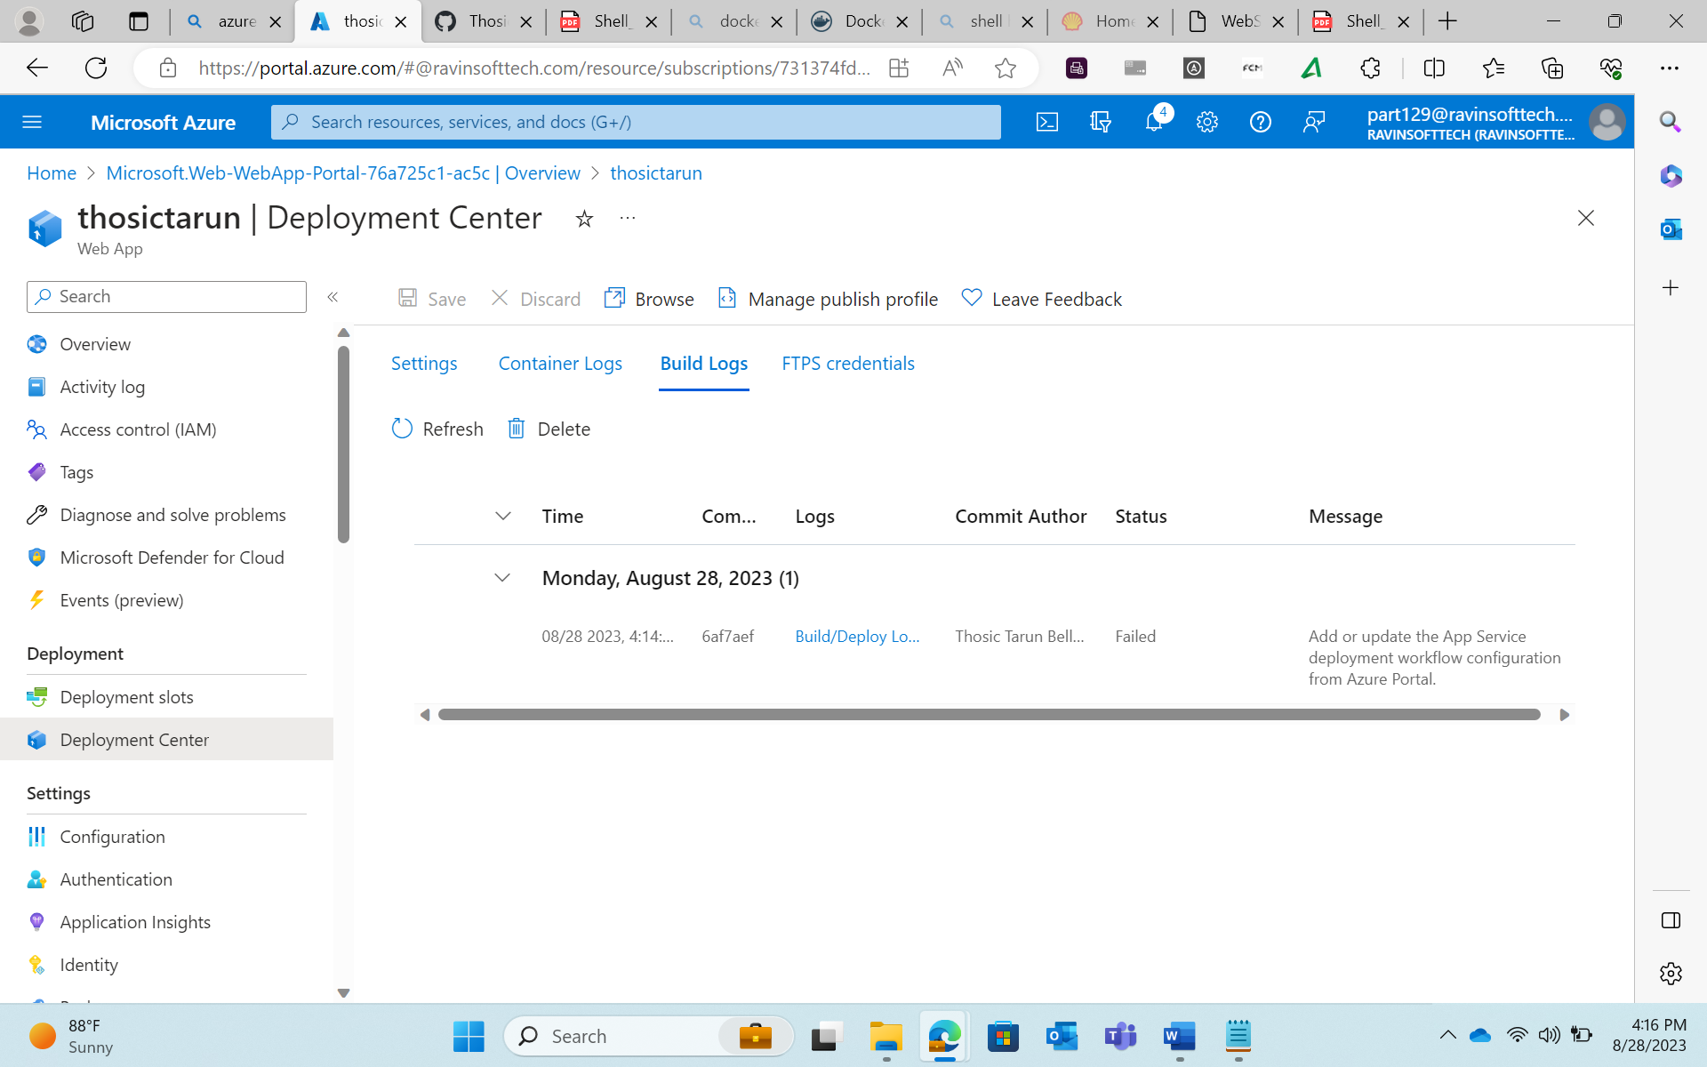

Slide 8
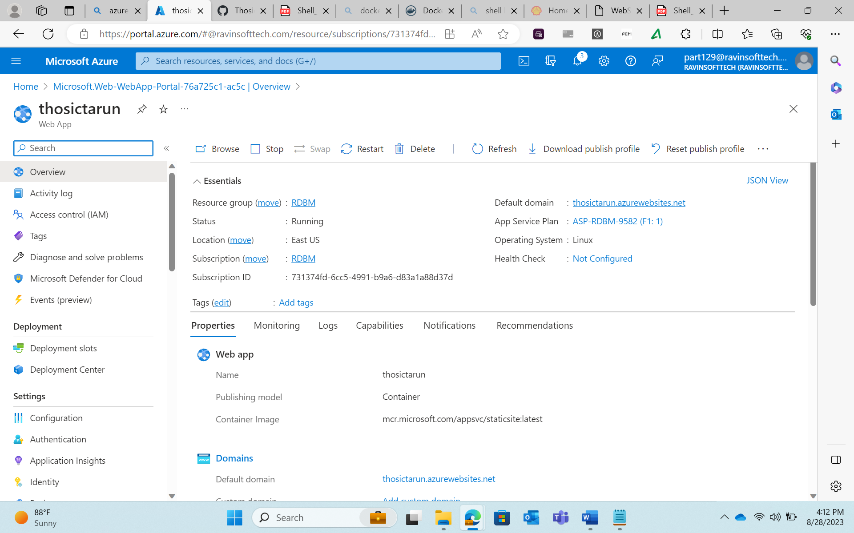

Slide 9
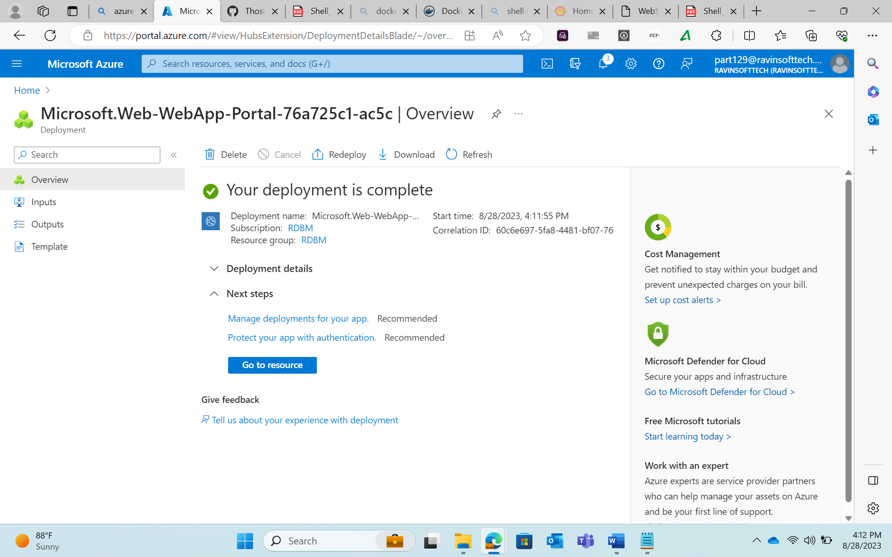

Slide 10
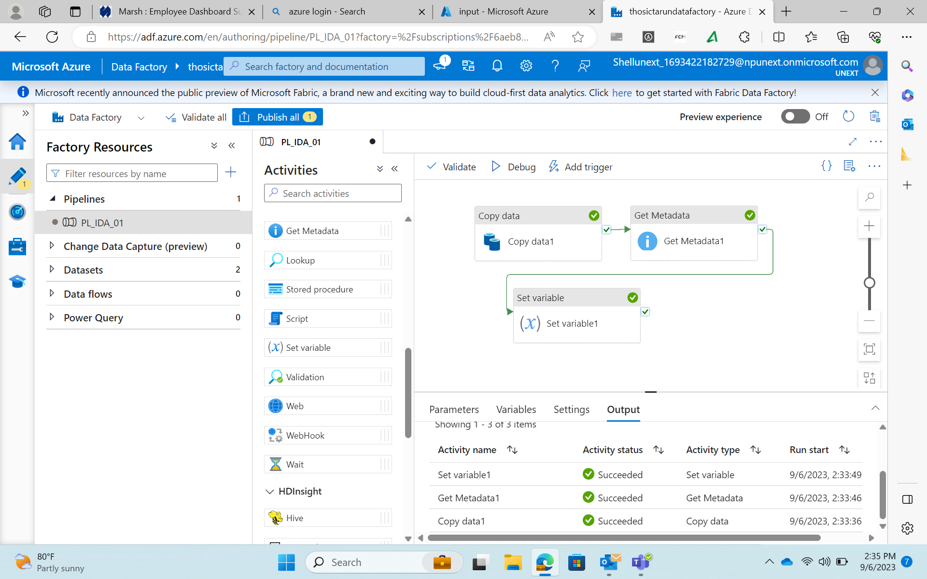

Slide 11
